Slide 1


SmartCampus Suite v4.3.0.9
Introducing SmartCampus Suite v4.3.0.9: A comprehensive campus-wide access and entitlement management system. This solution provides centralized control and streamlines campus operations.

Slide 2
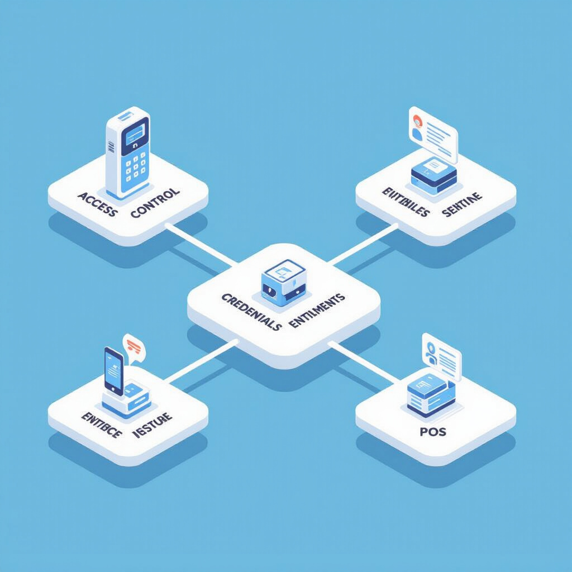
Product Overview
SmartCampus Suite centralizes access control, credential management, entitlement administration, and Point of Sale (POS) operations. It offers a unified platform for managing physical access and entitlements across the entire campus. This ensures seamless integration and enhanced security.

Slide 3
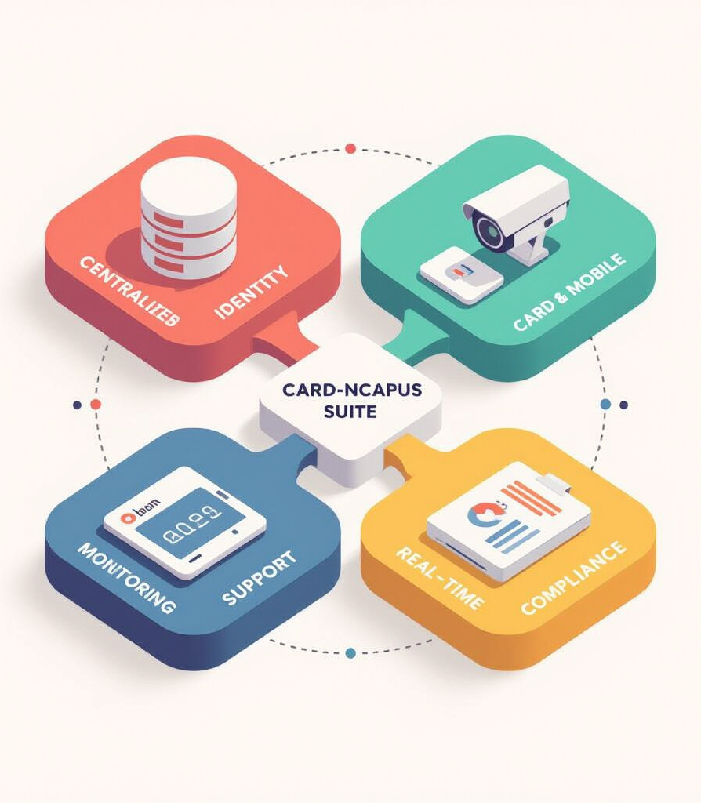
Goals of the System
The primary goals of SmartCampus Suite are:
Centralized Identity: Establish a single source of truth for campus identities.
Card & Mobile Support: Support both physical cards and mobile credentials for access.
Real-Time Monitoring: Provide real-time access monitoring and control capabilities.
Compliance Reporting: Generate comprehensive reports for regulatory compliance.

Slide 4
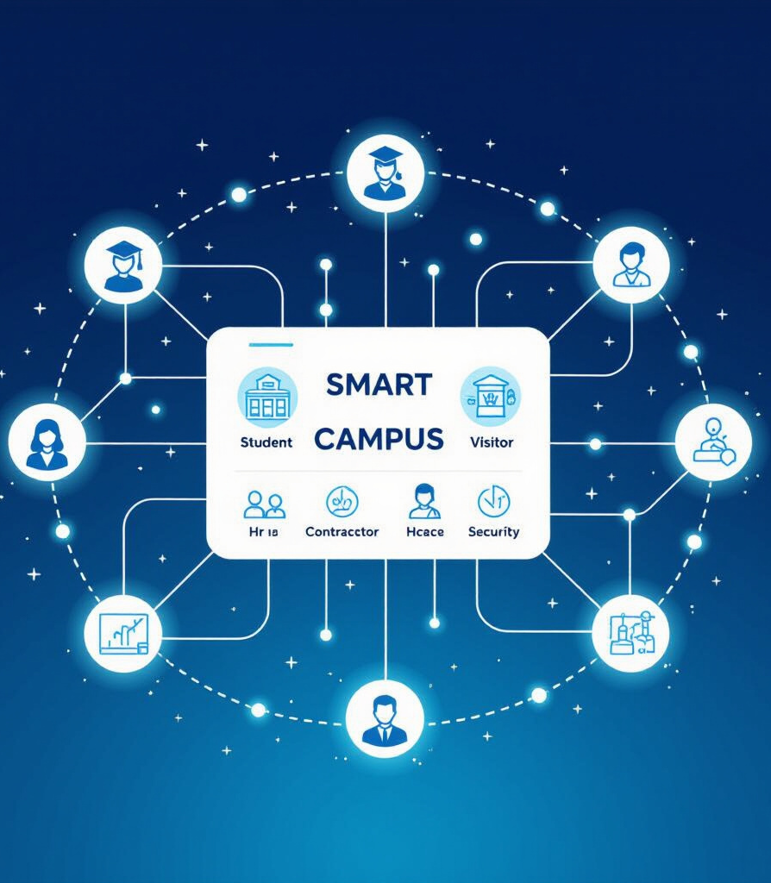
Key Users & Stakeholders
SmartCampus Suite serves various users and stakeholders:
Students: Access to dorms, labs, and other facilities.
Faculty: Access to offices, classrooms, and research areas.
Staff: Access to administrative buildings and operational areas.
Visitors: Temporary access to designated areas.
Contractors: Managed access for specific projects and durations.
HR: Onboarding and offboarding access management.
Cafeteria Managers: Meal plan administration and POS authorization.
Security Teams: Real-time monitoring and incident response.

Slide 5
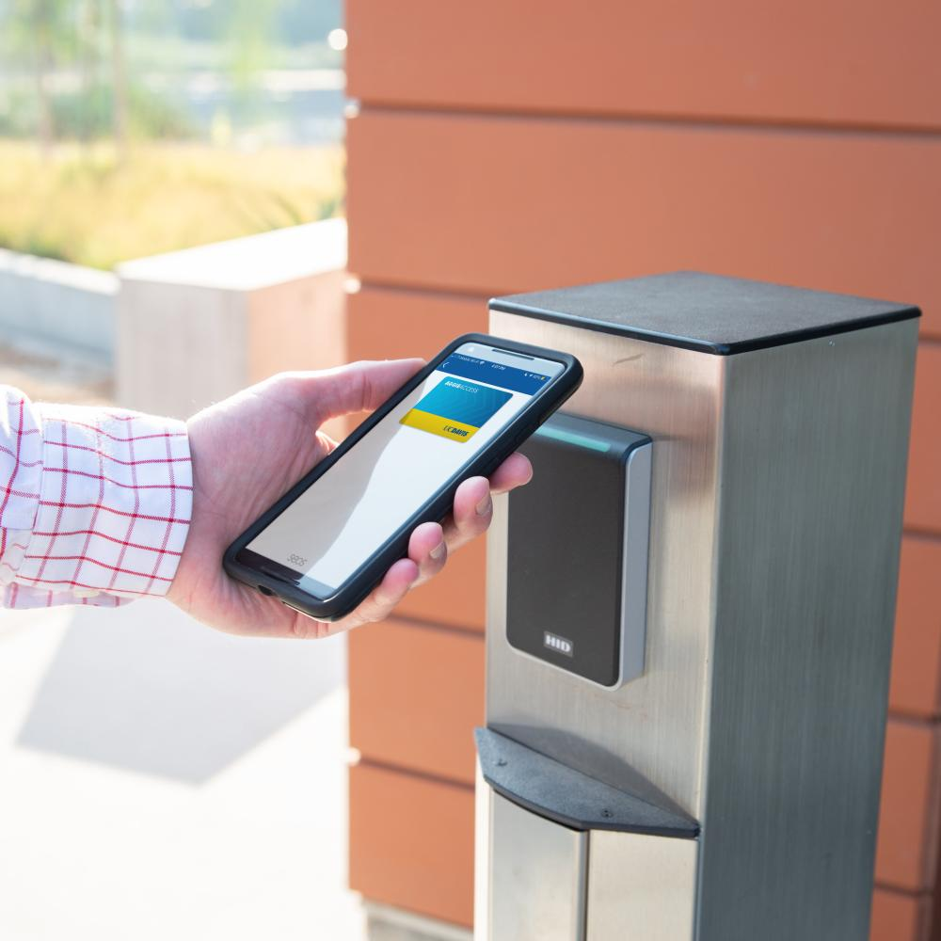
Hardware & Devices Supported
SmartCampus Suite supports a wide range of hardware and devices:
Door Readers: Various models and technologies for secure access points.
Turnstiles: Controlled entry and exit for high-traffic areas.
Kiosks: Self-service credential issuance and management.
POS Terminals: Integration with cafeteria and retail POS systems.
Printers: For printing temporary badges and reports.

Slide 6

Key Features
SmartCampus Suite offers a comprehensive suite of features:
Identity Lifecycle: Automated provisioning and deprovisioning of access rights.
Access Rules: Granular control over access permissions based on roles and groups.
Entitlements: Management of meal plans, library access, and other privileges.
POS Authorization: Secure authorization of transactions at POS terminals.
Audit Trails: Detailed logging of all access events for compliance and security.
Self-Service: User portal for managing credentials and reporting issues.
Admin Console: Centralized management interface for system administrators.

Slide 7

Reader Management (Screenshot View)
The Reader Configuration Module provides detailed information and settings for each reader:
Serial Number: Unique identifier for the reader device.
Location: Physical location of the reader within the campus.
Model: Specific model and manufacturer of the reader.
Supplier: Vendor from whom the reader was purchased.
Installation Date: Date when the reader was installed.
Linked Modules: Modules or systems integrated with the reader.

Slide 8

Example Use Cases
Security Admin: Creates zones for dorms, restricting access based on residency.
Cafeteria Manager: Designs flexible meal plans with varying allowances and restrictions.
Student: Reports a lost card and receives a temporary QR code for immediate access.
Registrar: Auto-revokes access permissions when a student withdraws or graduates.

Slide 9

Technical Architecture
SmartCampus Suite features a robust and scalable architecture:
Cloud Core: Centralized management platform hosted in a secure cloud environment.
Edge Gateway: Secure communication gateway between the cloud and on-premise devices.
Controllers/Readers: Deployed at access points to enforce access control policies.
Resilience Features: Offline synchronization and high availability ensure continuous operation. The system will continue to operate even during temporary network outages.

Slide 10

Compliance & Security
Security and compliance are paramount:
Encryption: End-to-end encryption to protect sensitive data.
FERPA Compliance: Adherence to data privacy regulations.
Anti-Cloning: Measures to prevent credential cloning and unauthorized access.
Audit Logging: Comprehensive audit logging for forensic analysis and compliance reporting.

Slide 11

Operations & Monitoring
SmartCampus Suite ensures reliable operation and proactive monitoring:
Uptime Targets: High availability and redundancy to meet stringent uptime requirements.
Logging: Centralized logging for troubleshooting and security analysis.
Backups: Regular backups to protect against data loss.
Disaster Recovery: Comprehensive disaster recovery plan to ensure business continuity.
Observability: Tools and dashboards for real-time monitoring of system health and performance.

Slide 12

Conclusion
SmartCampus Suite v4.3.0.9 is a reliable, compliant, and scalable solution for campus-wide access and entitlements. It offers a comprehensive platform for managing physical access, entitlements, and POS operations. Its robust features and architecture ensure enhanced security, streamlined operations, and regulatory compliance.

Slide 13



Want to know more?
Contact Information:
Iuliia Drabik
Product Manager
+38068824539 – iuliia.drabik@yavitkov.com.ua
Y.A. Vitkov F.O.P.
Malaya Arnautskaya 31,
Odessa 65023
Ukraine
Follow us on
www.yavitkov.com.ua/contacts

Slide 14
2018 © Y.A.Vitkov. All rights reserved.
This presentation and its contents are the confidential property of Y.A.Vitkov F.O.P and are provided solely for informational purposes. No part of this document may be reproduced, distributed, or transmitted in any form or by any means without the prior written permission.
This presentation may contain forward-looking statements that reflect management’s current expectations. Actual results may differ materially from those projected.
Any trademarks, service marks, or trade names used in this presentation remain the property of their respective owners and are used for identification purposes only.

Slide 15
Thank You

